Slide 1
Bingham Town Pavilion Redevelopment proposal

Slide 2
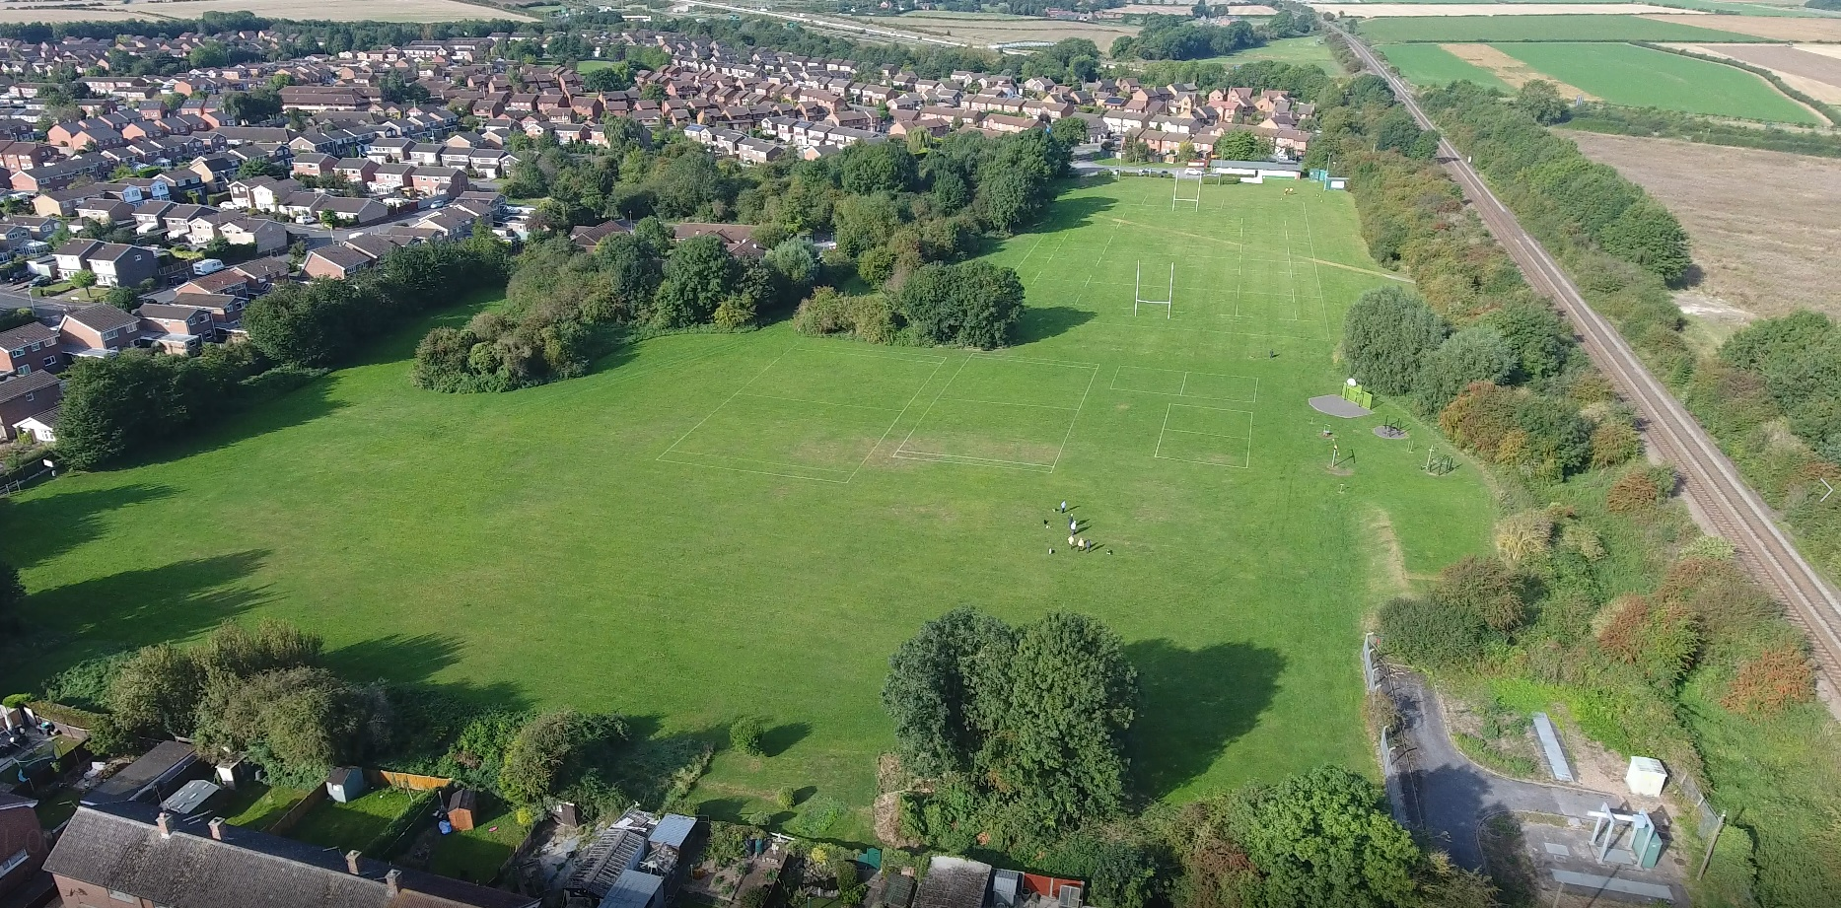
Bingham Town Pavilion Redevelopment proposal
Who Are We?

Slide 3
Bingham Town Pavilion Redevelopment proposal
Who Are We?
Bingham Town Pavilion - An existing community facility owned by Bingham Town Council
Leased to Bingham Rugby Club for almost 50 years
Successfully operated by a stewardship committee independent to BTC or RBC
Financially secure – has not require a subsidy to run since lease signed in 1971
Operated as a not for profit venture – all surplus proceeds re-invested into the facility
Add another image here of inside of clubhouse

Slide 4
Bingham Town Pavilion Redevelopment proposal
Who Are Our Users?
The Pavilion is NOT just a rugby club. All the below are current regular users

Slide 5
Bingham Town Pavilion Redevelopment proposal
Who Are Our Users?
Yes, we do also play rugby with players from ages 4 to over 50 and need more space
The only current facility in Bingham West with both a safe indoor and outside play / recreation / sports area we have a waiting list of potential users who have expressed an interest in the current or expanded facility, including:

Slide 6
Bingham Town Pavilion Redevelopment proposal
Where Are We?

Slide 7
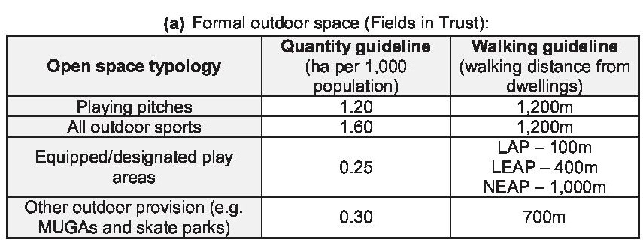
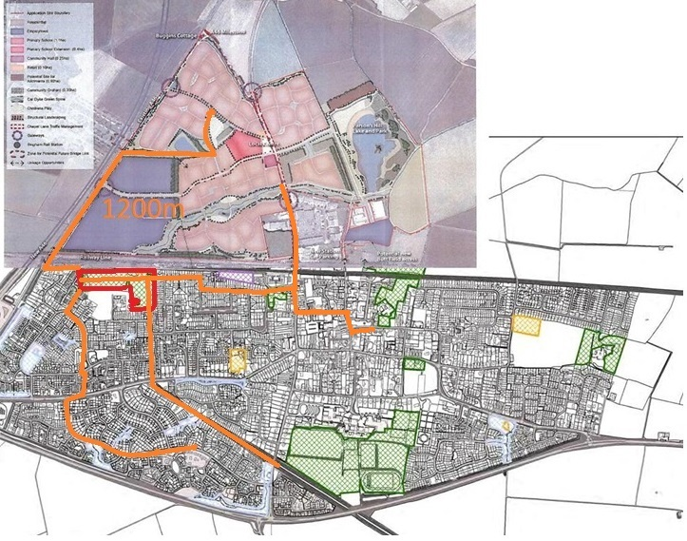
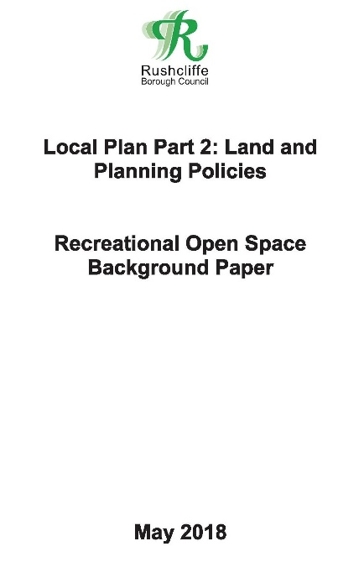
Bingham Town Pavilion Redevelopment proposal
Where Are We?

Slide 8
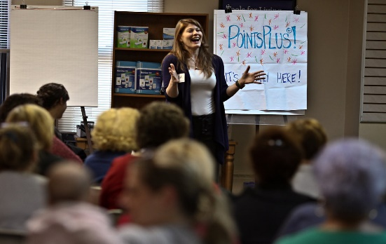
What are our objectives
Bingham Town Pavilion Redevelopment proposal
Expand the offering at The Pavilion to:
Meet known unmet demand
Reduce reliance on marquee for increased capacity
Increased capacity for sport & recreation for the future
Building continue to pay for itself Mon – Fri 9 am –10 pm
Increased community footprint with flexible, bigger rooms
Officials & Ladies changing capacity
1st aid / Physio room
More robust construction

Slide 9
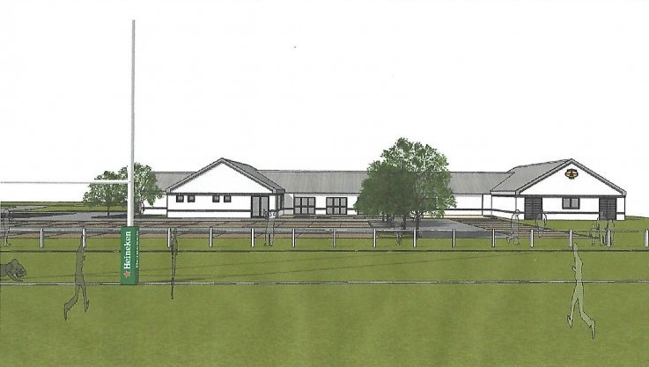
What do we propose
Bingham Town Pavilion Redevelopment proposal

Slide 10
What do we propose: Improved Community Space
Bingham Town Pavilion Redevelopment proposal
Over double current capacity
Combined community room 200m2 capacity of c180
Divider which can make 2 rooms:
102m2 & c100 sq m
Two users can use at once
Both have access to bar
New Meeting room for c10/12
Kitchen sized for weddings, etc
Increased parking (86 spaces)
Single level for disabled access
Cycle Storage

Slide 11
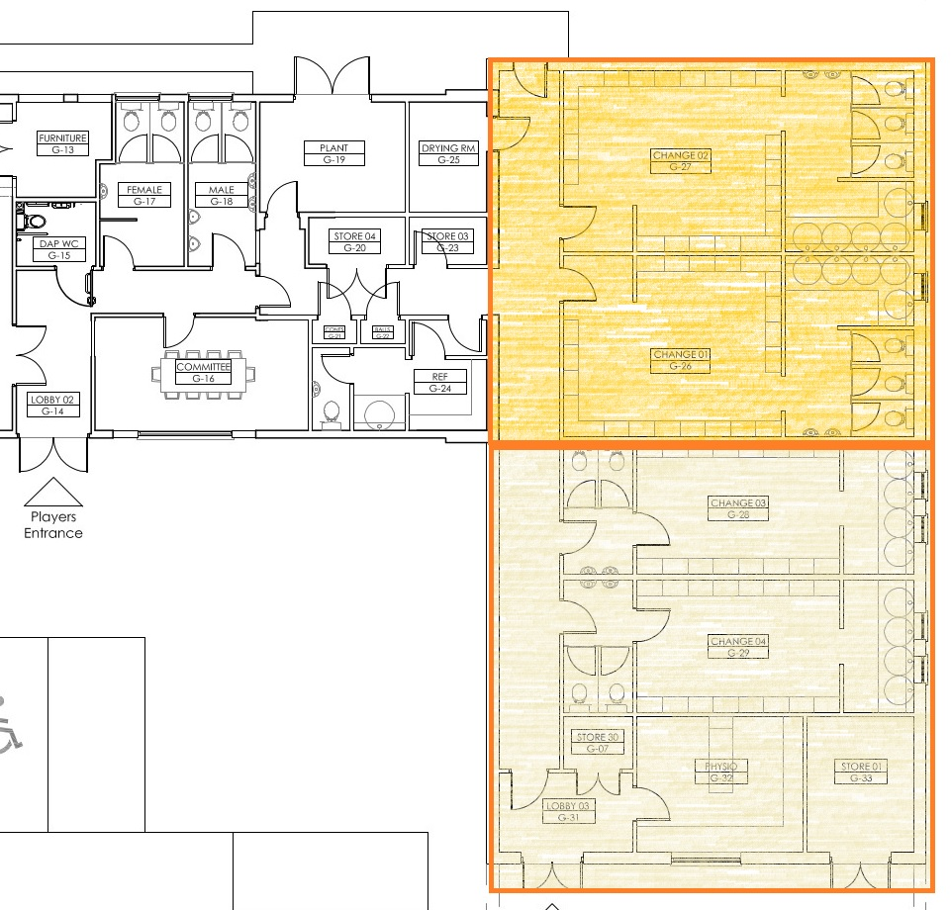
What do we propose: Improved Sports Changing
Bingham Town Pavilion Redevelopment proposal
More than double sports capacity
Introducing 2 new changing rooms which will:
Allow for an expansion of the Little Ruggers and Junior Rugby capacity
Allow more than one sport to get changed at the same time
Allowing for segregated changing (for example women’s football and male rugby)

Slide 12
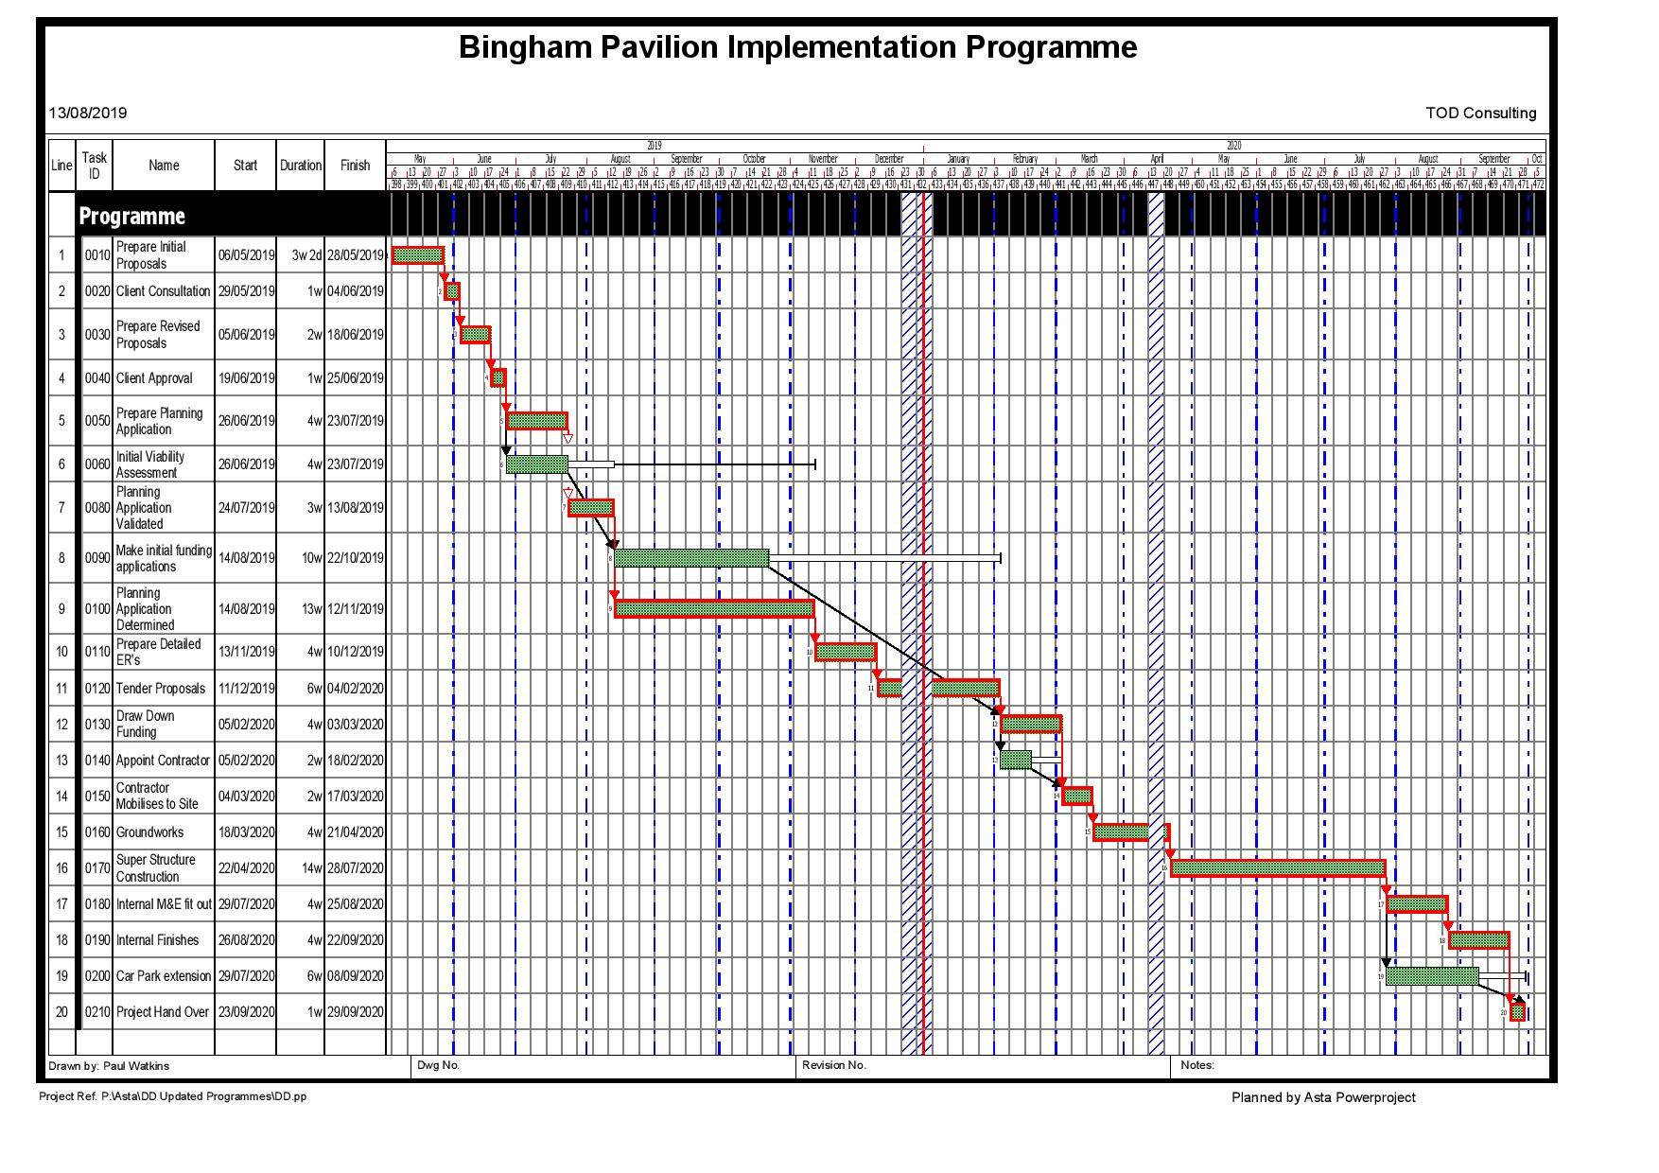
Our Delivery Timescales, Costings & Funding
Bingham Town Pavilion Redevelopment proposal
Delivery Programme
Planning Application Submitted & anticipated to be determined in November
QS Prepared Cost Estimate – Anticipated Construction Costs of £600,000
Professional Team appointed
Programme of works – 12 months
Subject to funding)
Anticipated Start Spring 2020
Anticipated completion Spring 2021
Sources of funding identified:
Sports Facilities:
RFU Loan £100,000 Committed
Sports England Grant – Advanced Negotiations
Community Facilities:
Bingham Community Chest S106 Monies.

Slide 13
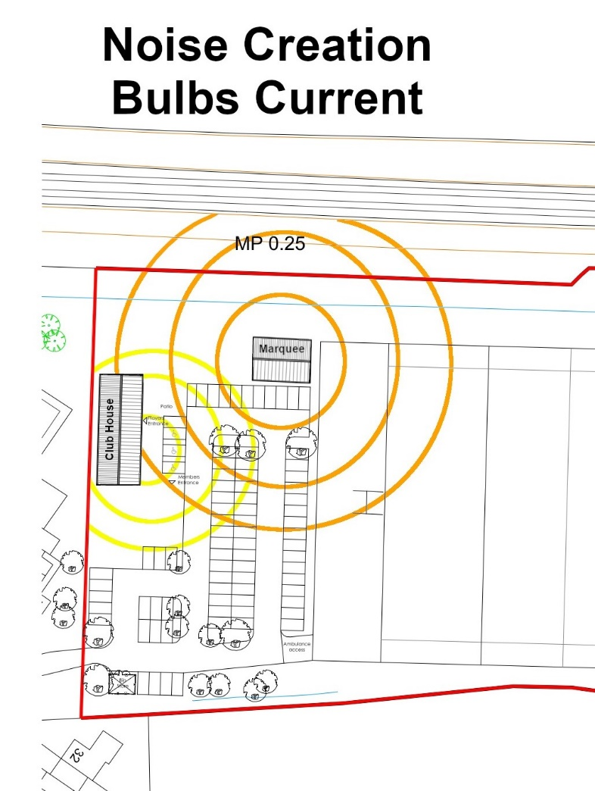
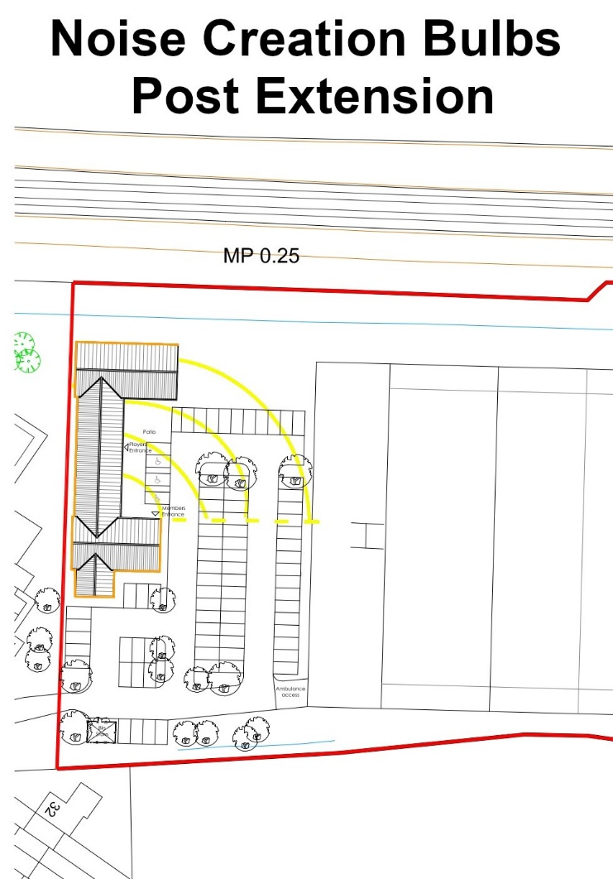
Bingham Town Pavilion Redevelopment proposal
Concerns raised by local residents
Noise
Our Architect’s plans comply with both planning and building regulations
Building expansion is directly South but with open areas facing East angling noise away from Brendon Grove
Extension will be of brick & mortar construction
Remove windows from southern elevation
Introduce acoustic fence at boundary to reduce car park noise

Slide 14
Bingham Town Pavilion Redevelopment proposal
Concerns raised by local residents
Car Parking
Larger car park will stop ‘over spill’ parking on Brendan Grove and surrounding streets
Tree Removal
We DO NOT propose to remove any trees as part of the proposal
Operating Hours
We are not proposing a change in hours.
Our identified demand is during the day time & early evening for community & local interest groups
Security
Car park barrier would remain to stop illegal parking
CCTV system with constant recording and remote access monitoring would be fitted allowing 24 hour surveillance
Vetting of users
We would continue to vet all potential users and one off bookings (we turn away far more bookings than we accept and would continue to apply the same standards)
Marquee
Other than for very large events (beer festival for example) the extension will remove our reliance on the use of a marquee for large scale bookings.

Slide 15
Bingham Town Pavilion Redevelopment proposal
Myth busting
1. “The Rugby Club has no proposal to open the facility to full community use”
Wrong –already open to community & in daily use by community groups from toddlers to those past 80
2. “Community halls do not generally provide a surplus and often run at a subsidy”
The Town Pavilion has not required a subsidy since entering into its lease in 1971
Differences to the Leisure Centre co-location proposal
We have both indoor and outdoor space which can be combined adding flexibility
(scouts, children’s parties, weddings, charity events, etc)
We have both a bar and kitchen facilities which allows for a wider range of bookings
(and is an essential source of income keeping our booking fees low)
Other ??????

Slide 16
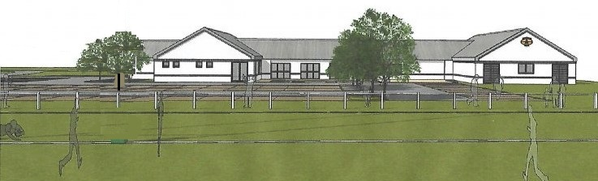
Bingham Town Pavilion Redevelopment proposal
Conclusions
The proposal is NOT an expansion of the Rugby Club, but of the Town Pavilion: an existing, multi-user community and sports facility owned by Bingham Town Council
The proposal has been designed, costed and submitted for Planning Consent.
We have identified a number of sources of funding which in totality would provide sufficient capital to pay for the works
The facility would not require any ongoing finance as running costs would be covered from income.
We are seeking BTC agreement & support to Enhance and Invest in an existing BTC asset for the benefit of the community.

Slide 17
Bingham Town Pavilion Redevelopment proposal
Our Concerns
Having worked for several months to prepare and submit competent proposals, which have including funding the considerable cost of an architect preparing detailed drawings and a planning application fee, we are concerned that the case for the expansion of the only community facility serving the west of Bingham will now be lost under the momentum being build by Rushcliffe Borough Council to gather all available funding to devote to their leisure and office development proposal off Chapel Lane. We would ideally seek to compliment the RBC proposal, but would highlight that:
We have carefully researched the availability of funding for our project and have very deliberately made a distinction between the sporting functions housed within the building and the community functions, which make up over 2/3rd of all uses.
We believe that the Bingham Community Chest was created to fund projects such as that which we are proposing, and equally believe that Rushcliffe have access to alternative ‘pots’ within S106 agreements, including;
David Wilson / Barratt Development (Crown Estate): Leisure and Wellbeing Contribution £600,000 for “the provision of new or improved community leisure facilities within Bingham including but not limited to the Community Centre, leisure centres, sports pitches and multi-use games areas”
William Davis: Sports Hall Contribution £134,555 “towards the provision and/or improvement of sports halls in Radcliffe on Trent and/or Bingham”
William Davis: Swimming Pool Contribution £147,564 “towards the improvement or provision of a replacement swimming pool at Bingham Leisure Centre”

